Slide 1
Data Visualization

Slide 2
A definition of Visualization?

Slide 3
To communicate information with graphical representations of data

Slide 4
Two types of Visualization
Communicate (Explanatory)
Present data and ideas
Explain and inform
Provide evidence and support
Influence and Persuade
Analyze (Exploratory)
Explore the data
Assess a situation
Determine how to proceed
Decide what to do
Source: Harvard CS109 – Hanspeter Pfister and Joe Blitzstein
http://cs109.org

Slide 5
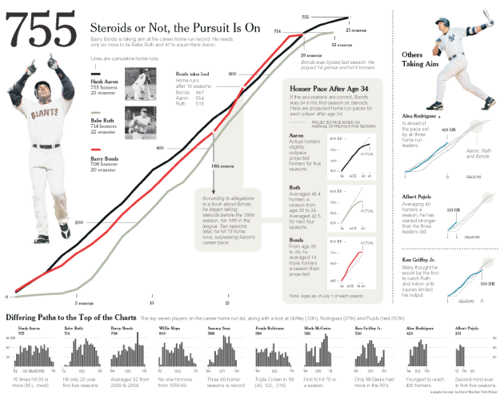
Communicate (Explain)
Source: Edward Segel and Jeffrey Heer, Narrative Visualization: Telling Stories with Data

Slide 6
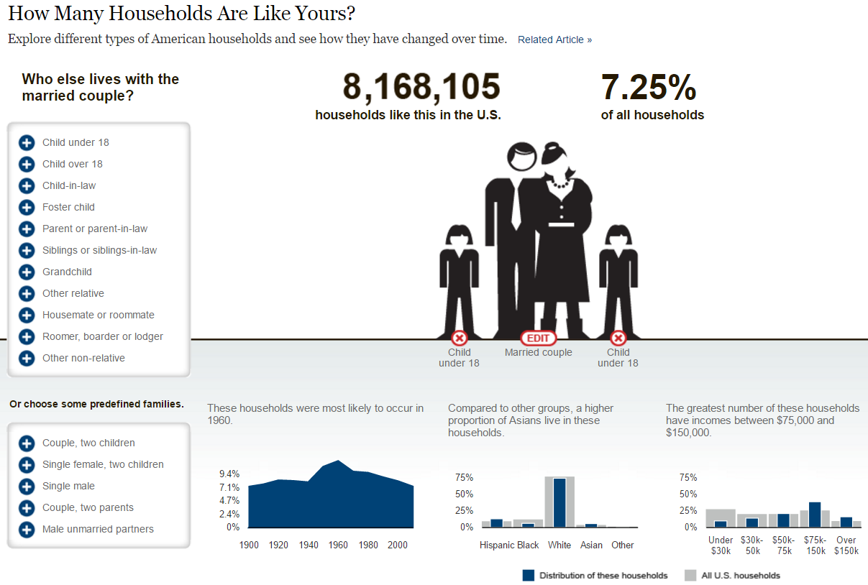
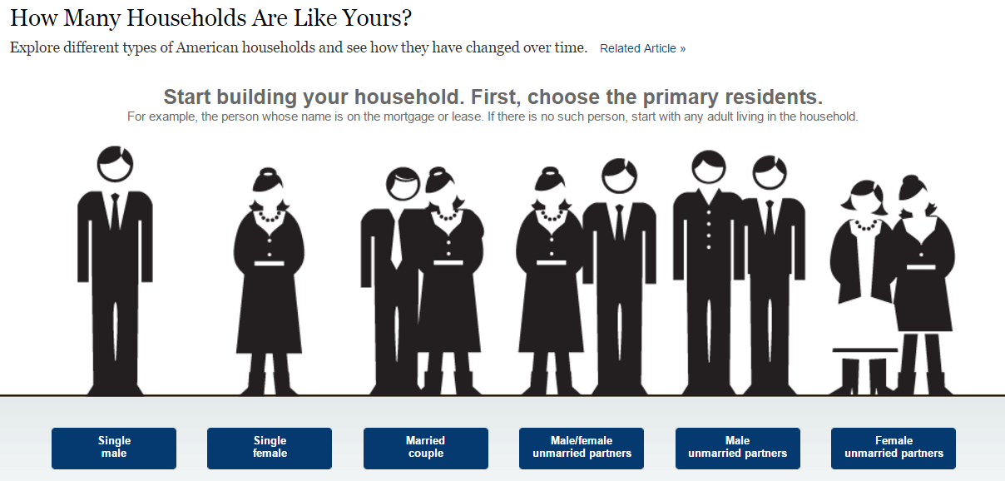
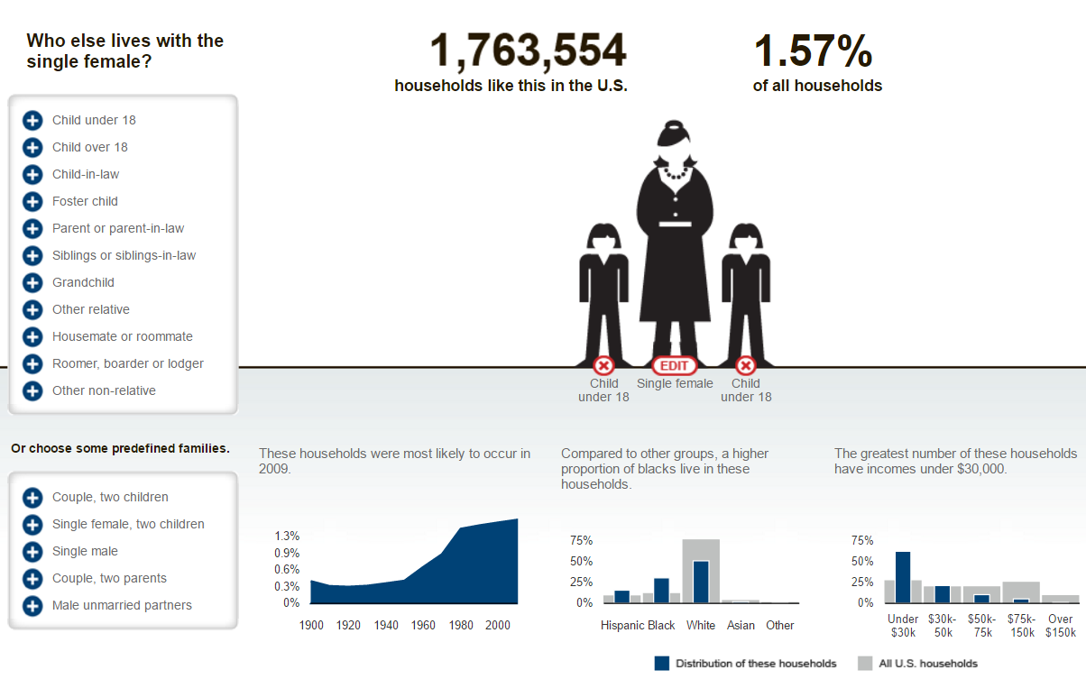
Analyze (Exploratory)
Source: http://www.nytimes.com/interactive/2011/06/19/nyregion/how-many-households-are-like-yours.html

Slide 7
What makes an Effective Visualization?

Slide 8
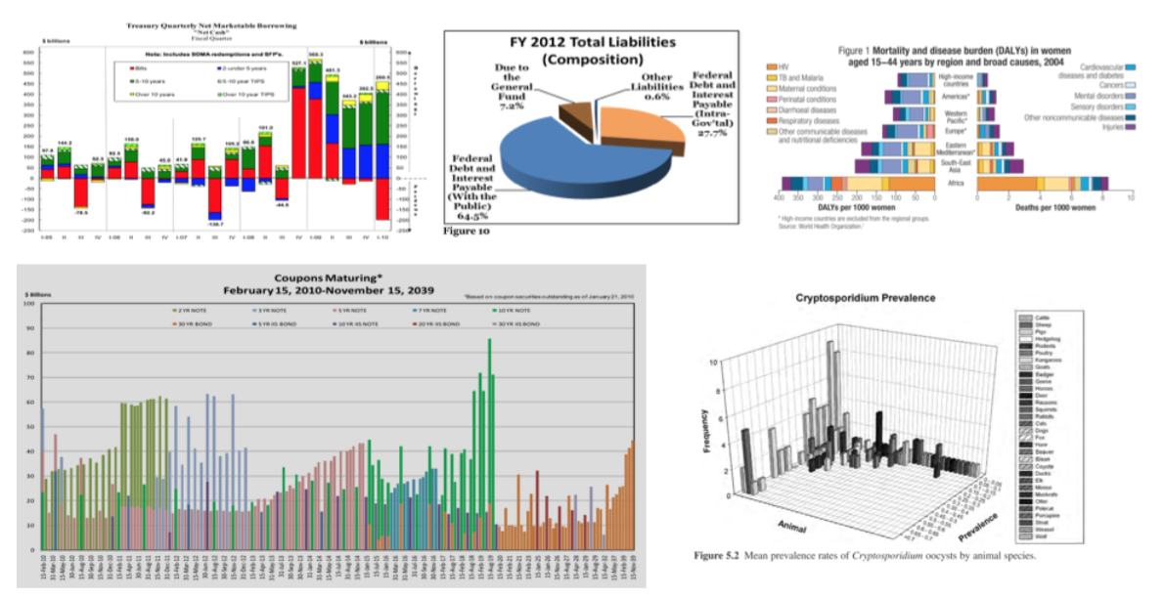
Ineffective Visualizations

Slide 9
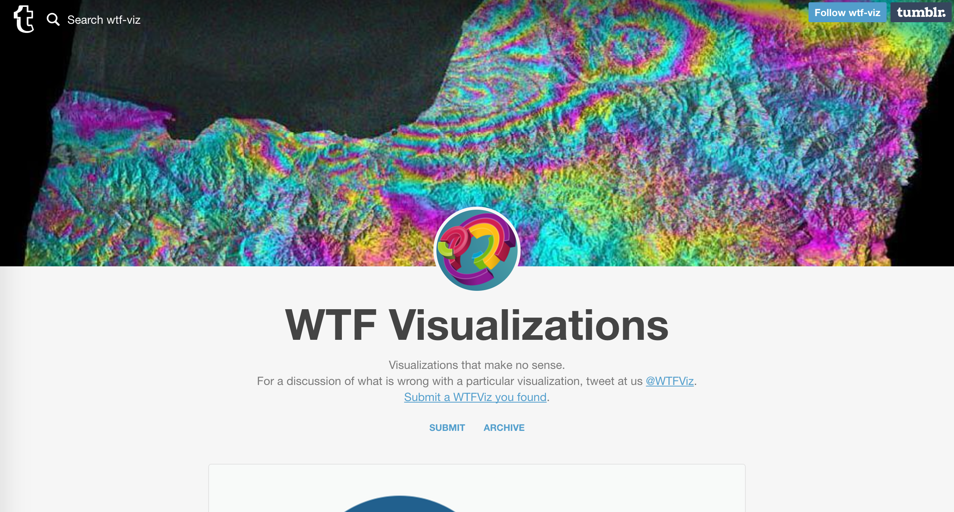
WTF Visualizations

Slide 10
Effective Visualizations
Have graphical integrity
Keep it simple
Choose the right display
Use color strategically
Tell a story with data
Source: Harvard CS109 – Hanspeter Pfister and Joe Blitzstein
http://cs109.org

Slide 11
Graphical Integrity

Slide 12
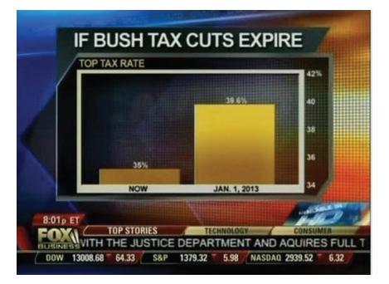
Graphical Integrity
Fox Business used a graphic with a badly distorted scale to exaggerate the effect that the expiration of the Bush tax cuts would have on the rich
The bottom number on the vertical axis is not zero
The way this is graphed, it depicts a visual increase of 460%, which is not true
Source: http://mediamatters.org/blog/2012/07/31/dishonest-fox-chart-bush-tax-cut-edition/189046

Slide 13
Graphical Integrity: Scale Distortions
Original chart with non-zero baseline
Original chart revisited with zero baseline
Source: http://mediamatters.org/blog/2012/07/31/dishonest-fox-chart-bush-tax-cut-edition/189046

Slide 14
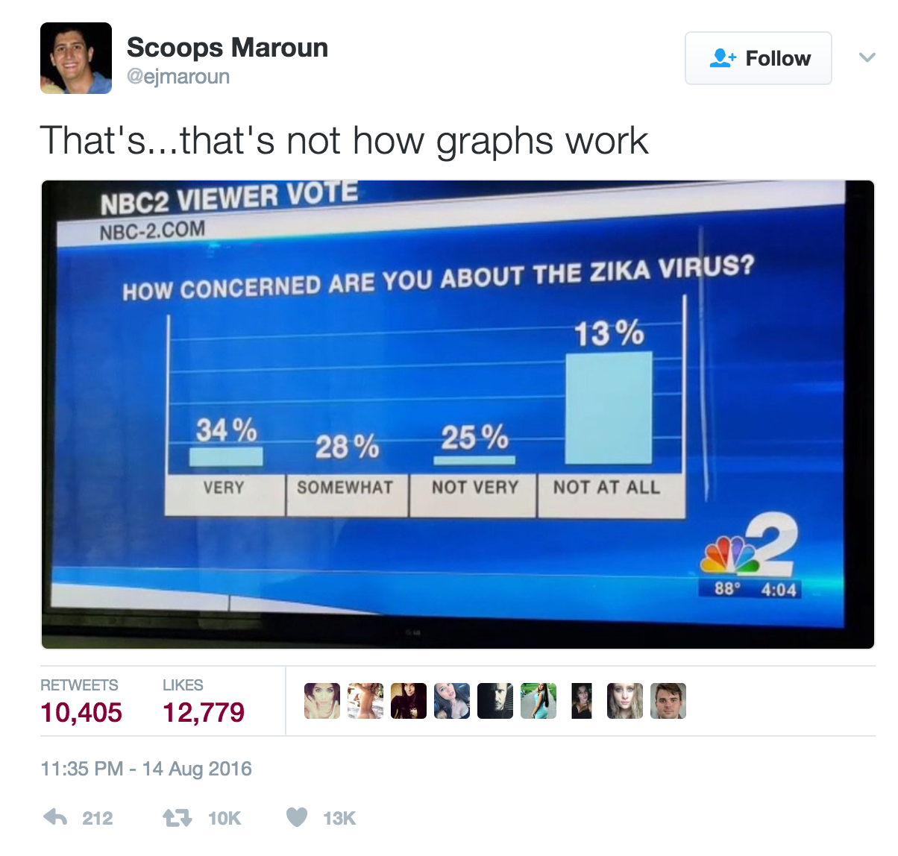
Graphical Integrity: Scale Distortions
Source: http://mediamatters.org/blog/2012/07/31/dishonest-fox-chart-bush-tax-cut-edition/189046

Slide 15
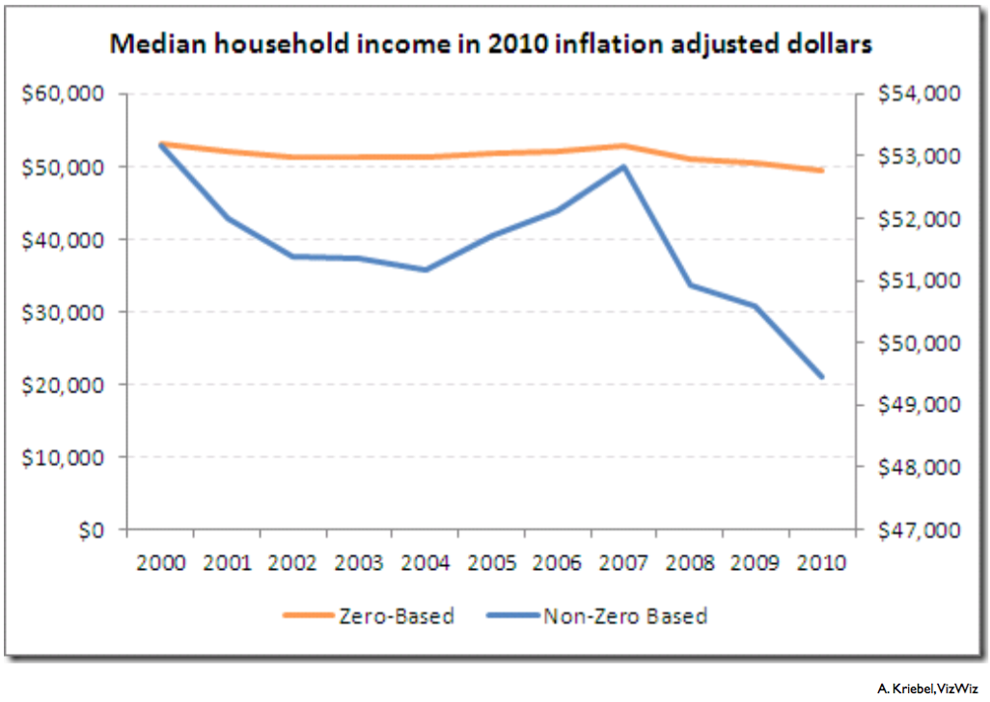
Graphical Integrity
Is about being HONEST with your data.
Source: Harvard CS109 – Hanspeter Pfister and Joe Blitzstein
http://cs109.org

Slide 16
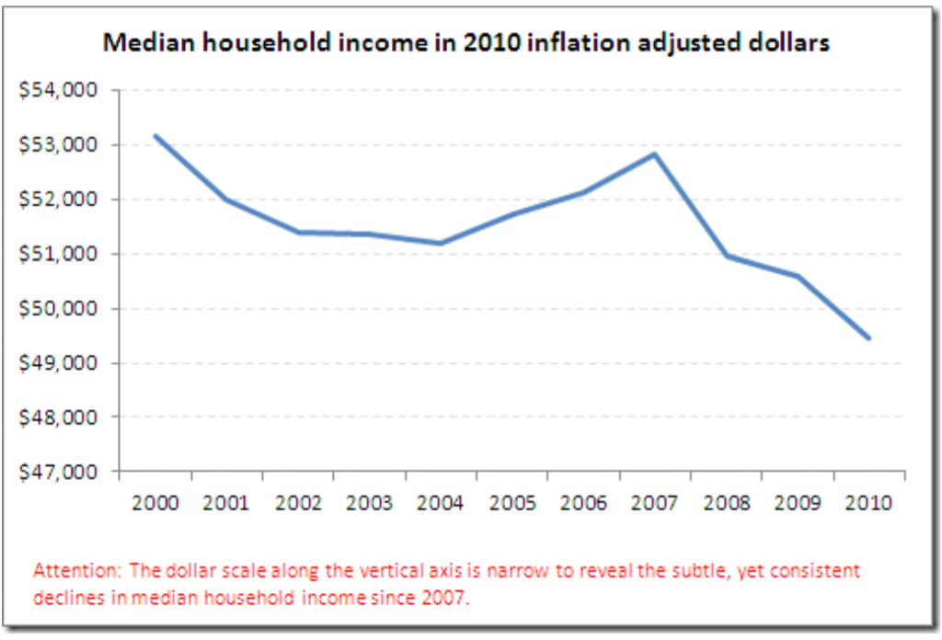
Graphical Integrity
Is about being HONEST with your data.
Source: Harvard CS109 – Hanspeter Pfister and Joe Blitzstein
http://cs109.org

Slide 17
Keep It Simple

Slide 18
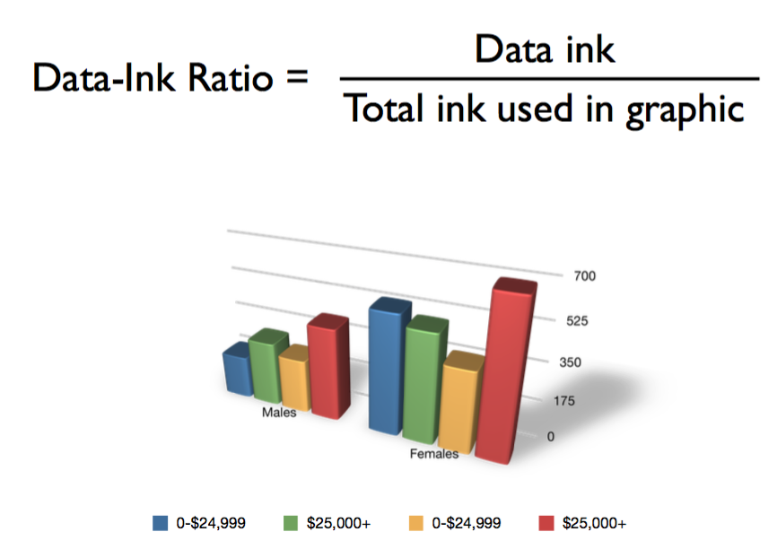
Maximize Data-Ink Ratio
Source: Harvard CS109 – Hanspeter Pfister and Joe Blitzstein
http://cs109.org

Slide 19
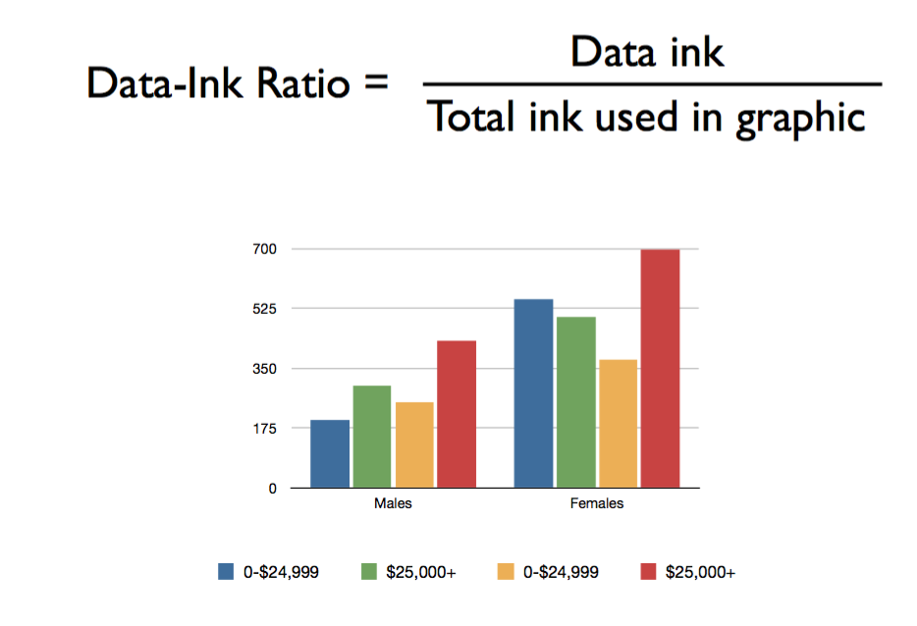
Maximize Data-Ink Ratio
Source: Harvard CS109 – Hanspeter Pfister and Joe Blitzstein
http://cs109.org

Slide 20
Maximize Data-Ink Ratio
Source: Harvard CS109 – Hanspeter Pfister and Joe Blitzstein
http://cs109.org

Slide 21
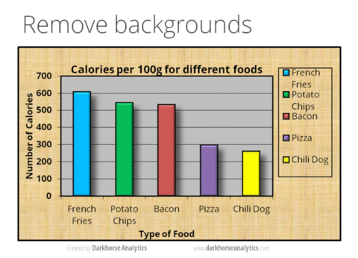
Less is more!

Slide 22
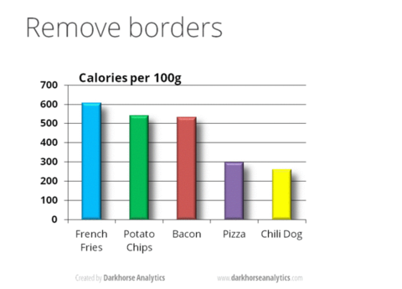
Less is more!

Slide 23
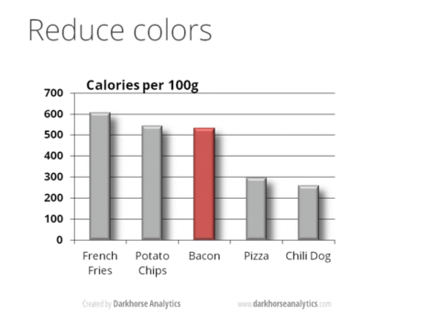
Less is more!

Slide 24
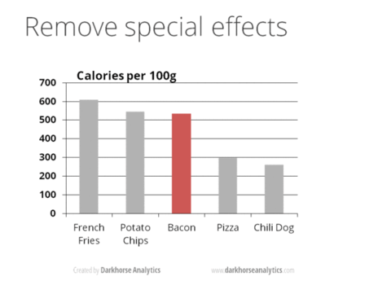
Less is more!

Slide 25
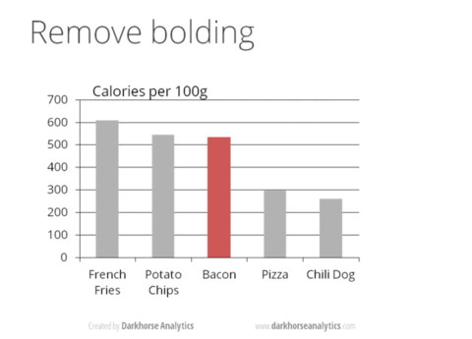
Less is more!

Slide 26
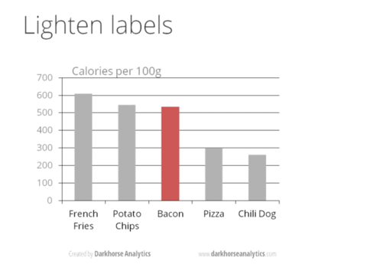
Less is more!

Slide 27
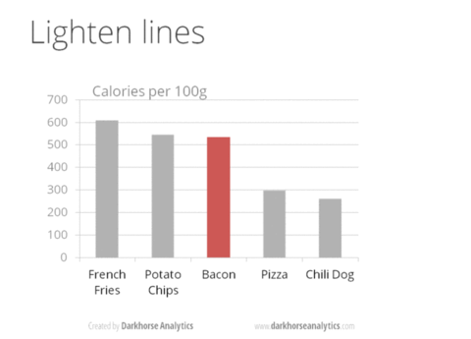
Less is more!

Slide 28

Less is more!

Slide 29
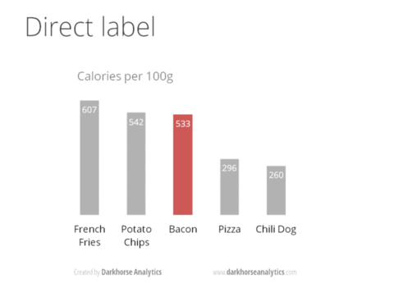
Less is more!

Slide 30
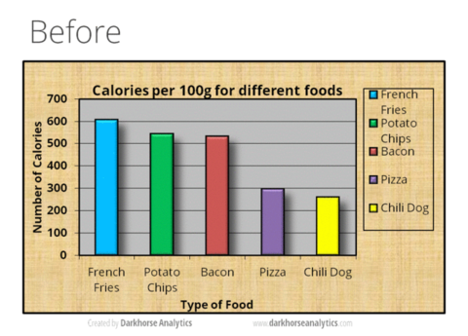
Less is more!

Slide 31
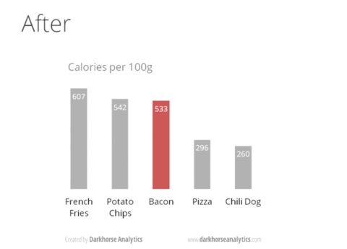
Less is more!

Slide 32
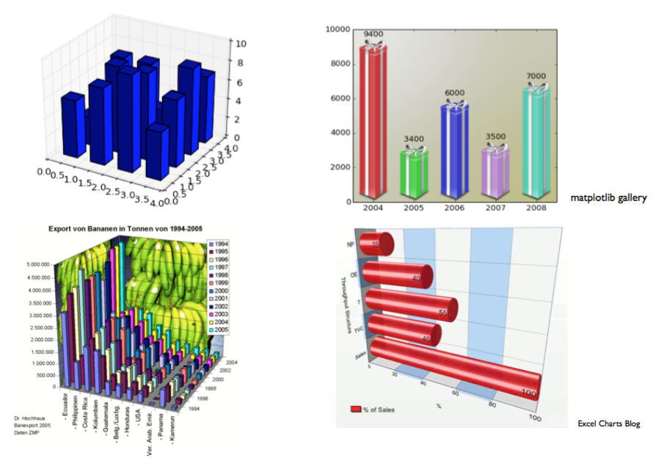
Don’t do this
Source: Harvard CS109 – Hanspeter Pfister and Joe Blitzstein
http://cs109.org

Slide 33
Choose the right display

Slide 35
Comparisons

Slide 36
Vertical bar chart
Single series
Vertical bar charts can be single series, two series, or multiple series
The more series of data, the more difficult to focus on one at a time and pull out insight, so multiple series bar charts should be used with caution
There is visual grouping that happens as a result of the spacing in bar charts having more than one data series
This makes the relative order of the categorisation important
We need to consider what the audience to be able to compare, and structure the categorisation hierarchy to make that as easy as possible
Two series
Multiple series

Slide 37
Horizontal bar chart
Single series
Best choice for categorical data because it is extremely easy to read
This is very useful if the category names are long, as the text is written from left to right, as most audiences read, making the graph legible for your audience
In addition, this chart helps to process the displayed content easily because we read the category names before the actual data
In contrast, vertical bar charts forces our eyes to move several times between data and category names
Two series
Multiple series

Slide 38
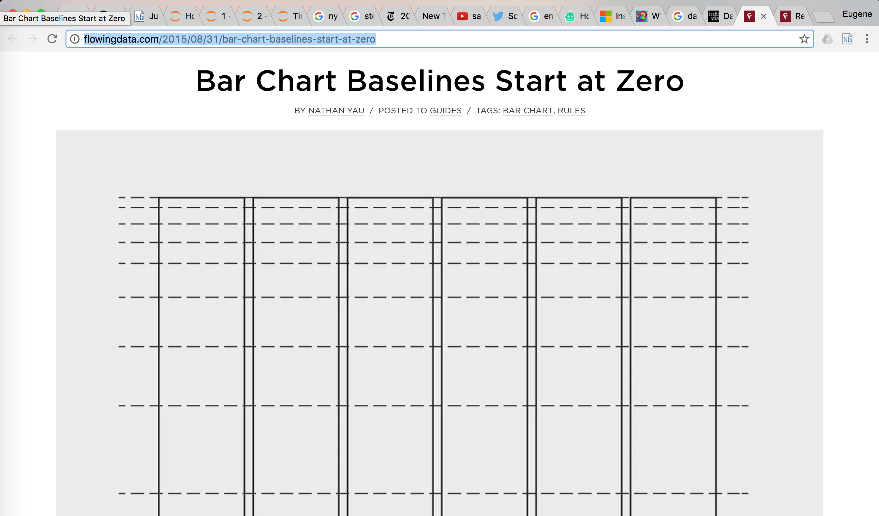

Slide 39
Trends

Slide 40
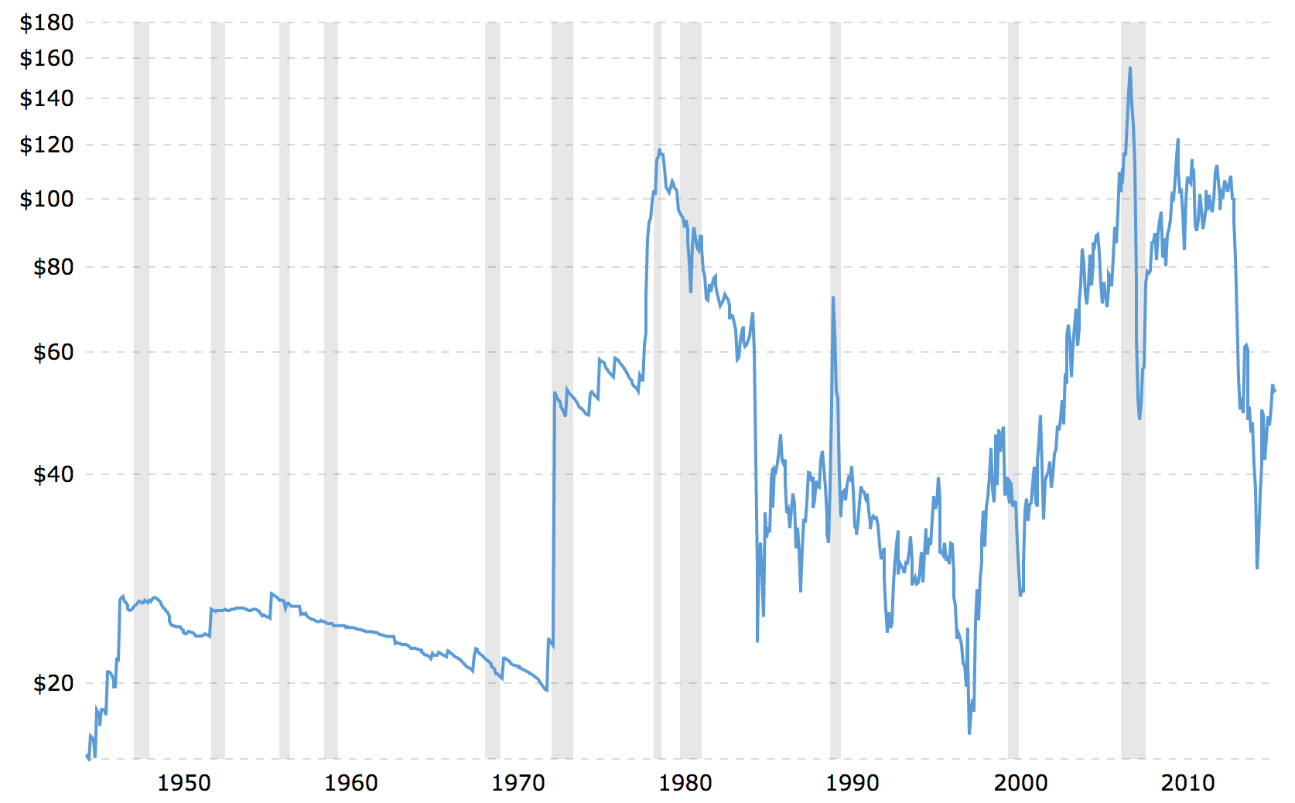

Slide 41
Lines
Commonly used to plot continuous data
Points are physically connected via the line
Implies a connection between the points

Slide 42
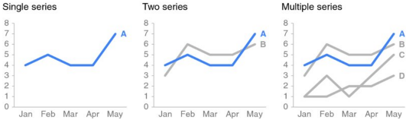
Line Graphs
The line graph can show a single series of data, two series of data, or even multiple series
The line graph can also represent a summary statistic, like an average

Slide 43
Proportions

Slide 44
Pie Chart

Slide 45
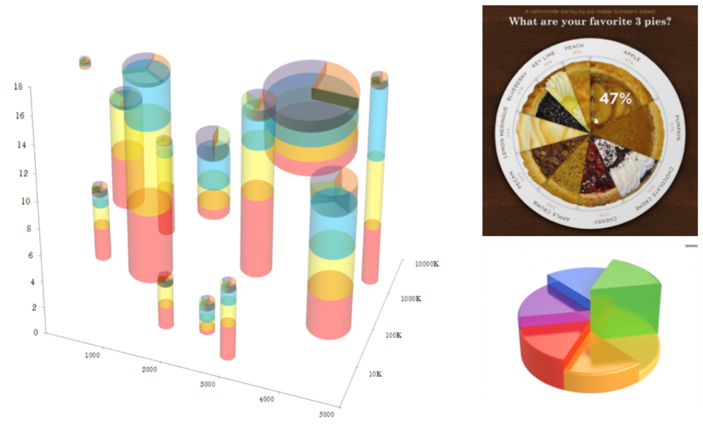
Eager pies
Source: Harvard CS109 – Hanspeter Pfister and Joe Blitzstein
http://cs109.org ; eagerpies.com

Slide 46
Stacked vertical bar chart
Comparing these is easy
Use cases for stacked vertical bar charts are more limited
They are meant to help to compare totals across categories and also see the subcomponent pieces within a given category
This can quickly become visually overwhelming
It is hard to compare the subcomponents across the various categories once we get beyond the bottom series because we no longer have a consistent baseline to use to compare.
Comparing these is hard

Slide 47
Stacked horizontal bar chart
This can be used to show the totals across different categories but also give a sense of the subcomponent pieces, and can be structured to show either absolute values or sum to 100%
Very useful for visualising portions of a whole on a scale from negative to positive, because we get a consistent baseline on both the far left and the far right, allowing for easy comparison of the left‐most pieces as well as the right‐most pieces
Example: Visualisation of survey data collected along a Likert scale (a scale commonly used in surveys that ranges from Strongly Disagree to Strongly Agree)

Slide 48
Correlations

Slide 49
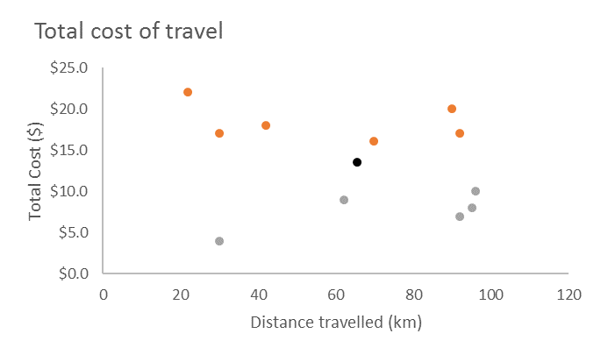
Points: Scatterplot
Useful for showing relationships between two things
Pre-attentive attributes can be used to draw attention to points of interest
AVG

Slide 50
Points: Scatterplot

Slide 51
Don’t do this

Slide 52
Some others

Slide 53
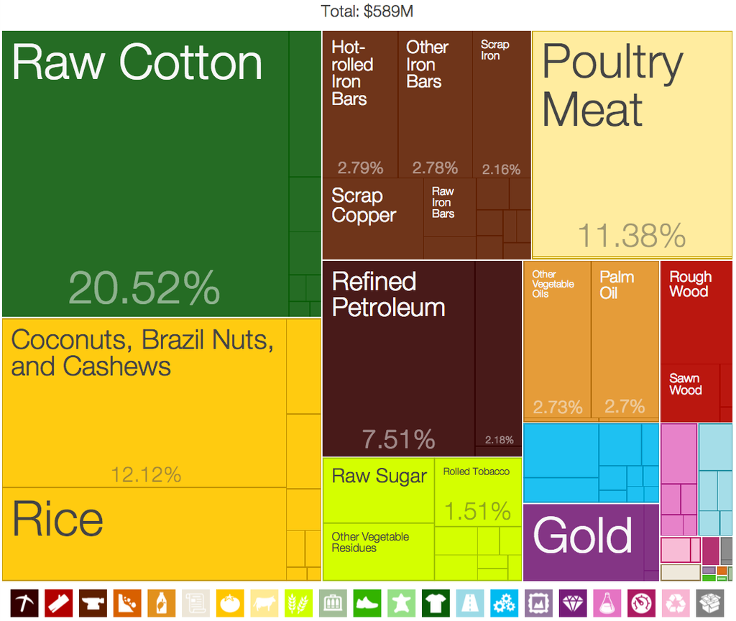
Treemap
Treemaps display hierarchical data as a set of nested rectangles. Each branch of the tree is given a rectangle, which is then tiled with smaller rectangles representing sub-branches. A leaf node's rectangle has an area proportional to a specified. Often the leaf nodes are coloured to show a separate dimension of the data
When the colour and size dimensions are correlated in some way with the tree structure, one can often easily see patterns that would be difficult to spot in other ways, such as if a certain colour is particularly relevant. A second advantage of treemaps is that, by construction, they make efficient use of space. As a result, they can legibly display thousands of items on the screen simultaneously
Treemap of Benin's exports by product category, 2009. The Product Exports Treemaps are one of the most recent applications of these kind of visualisations, developed by the Harvard-MIT Observatory of Economic Complexity

Slide 54
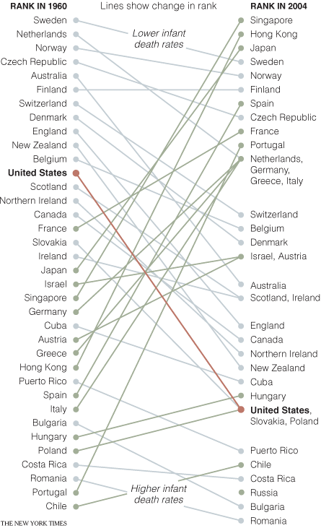
Lines: Slopegraph
Useful for quickly showing relative increases and decreases or difference across various categories between two data points.
The lines that connect two data points give you the visual increase or decrease in rate of change via slope or direction

Slide 55
Text
When there is only one or two numbers to show, simple text can be very effective
Children with a “traditional” stay-at-home mother
% of children with a married stay-at-home mother with a working husband
Source: Pew Research Center
20%
of children had a traditional stay-at-home mom in 2012, compared to 41% in 1970
Adapted from Knaflic

Slide 56
Tables
Tables interact with our verbal system: We usually read them
Great for communicating to a mixed audience where everyone will look for their particular row of interest (ideal for written reports)
In contrast, in live presentations they should be rarely used (because the audience’s focus deviates from the speaker to the table), rather we should identify and highlight the pieces of interest
When using tables, make sure to make the design fade into the background
Let the data take the center stage
Product | Metric 1 | Metric 2 | Metric 3
A | $1 | 10% | 123.1
B | $2 | 20% | 121.1
C | $3 | 30% | 212.2
D | $4 | 40% | 432.5

Slide 57
Improving the legibility of tables
Light borders
Product | Metric 1 | Metric 2 | Metric 3
A | $1 | 10% | 123.1
B | $2 | 20% | 121.1
C | $3 | 30% | 212.2
D | $4 | 40% | 432.5
Heavy borders
Product | Metric 1 | Metric 2 | Metric 3
A | $1 | 10% | 123.1
B | $2 | 20% | 121.1
C | $3 | 30% | 212.2
D | $4 | 40% | 432.5
Minimal borders
Product | Metric 1 | Metric 2 | Metric 3
A | $1 | 10% | 123.1
B | $2 | 20% | 121.1
C | $3 | 30% | 212.2
D | $4 | 40% | 432.5
When using tables, make sure to make the design fade into the background
Let the data take the center stage

Slide 58
Ηeatmap
Heatmap is a special case of tables
Tabular display of data, where in place of (or in addition to) the numbers, coloured cells convey the relative magnitude of those numbers
Colour saturation provides visual cues, helping our eyes and brains more quickly zero in on the potential points of interest
Heatmap
LOW-HIGH
Table
 | Product 1 | Product 2 | Product 3
A | 10% | 23% | 5%
B | 20% | 47% | 76%
C | 25% | 89% | 34%
D | 35% | 27% | 95%
 | Product 1 | Product 2 | Product 3
A | 10% | 23% | 5%
B | 20% | 47% | 76%
C | 25% | 89% | 34%
D | 35% | 27% | 95%

Slide 59
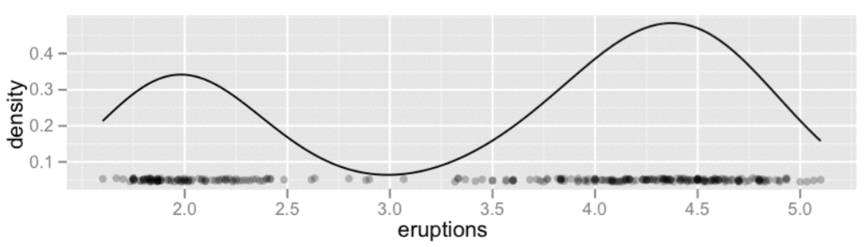
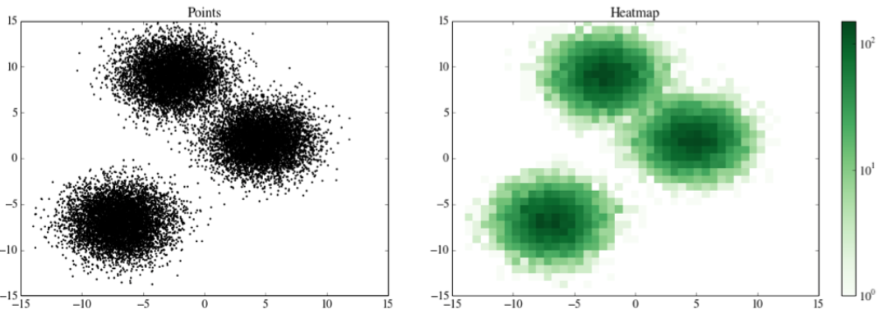
Density Plots
Source: Harvard CS109 – Hanspeter Pfister and Joe Blitzstein
http://cs109.org

Slide 60
Design Exercise

Slide 61
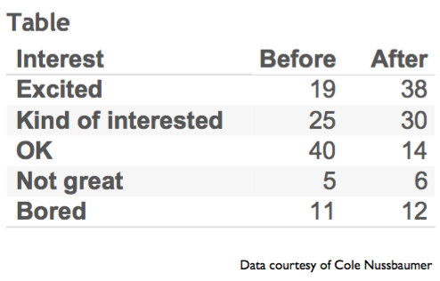
Before and after a pilot summer learning science program
Source: Harvard CS109 – Hanspeter Pfister and Joe Blitzstein
http://cs109.org

Slide 62
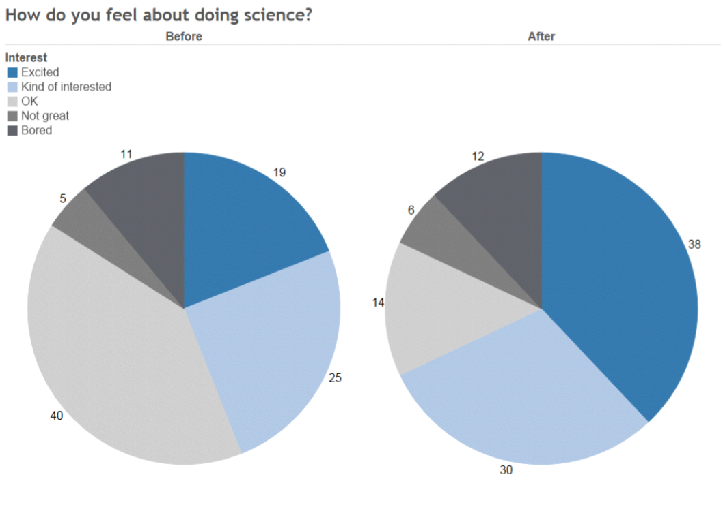
Source: Harvard CS109 – Hanspeter Pfister and Joe Blitzstein
http://cs109.org

Slide 63
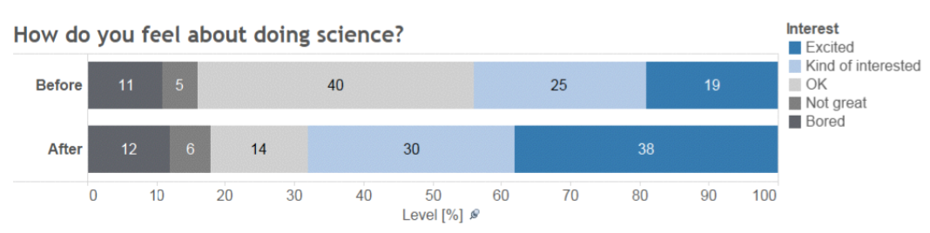
Source: Harvard CS109 – Hanspeter Pfister and Joe Blitzstein
http://cs109.org

Slide 64
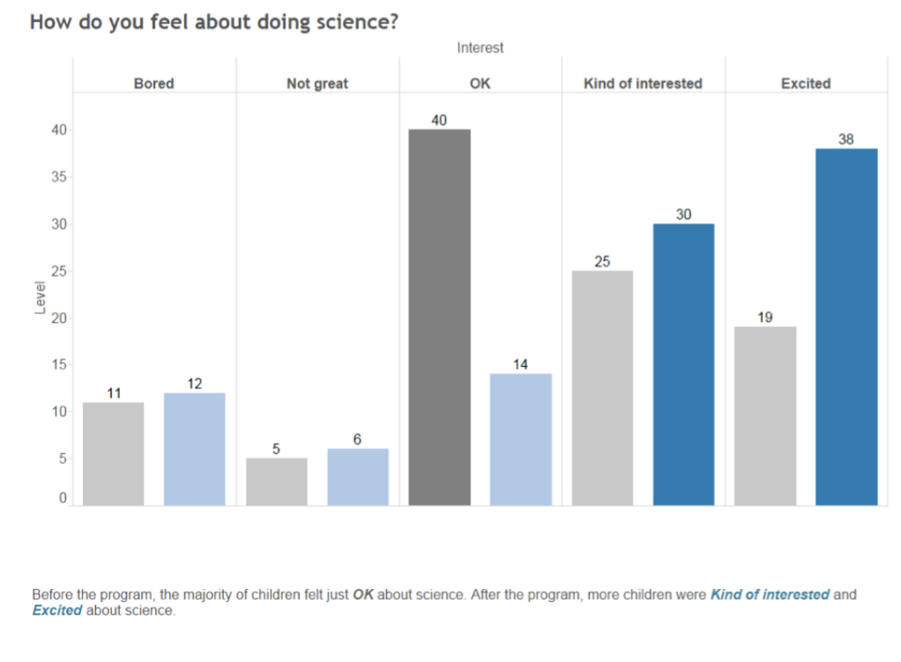
Source: Harvard CS109 – Hanspeter Pfister and Joe Blitzstein
http://cs109.org

Slide 65
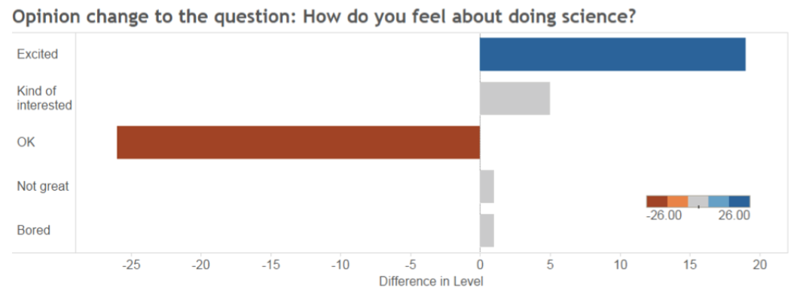
How do you feel about doing science?
Source: Harvard CS109 – Hanspeter Pfister and Joe Blitzstein
http://cs109.org

Slide 66
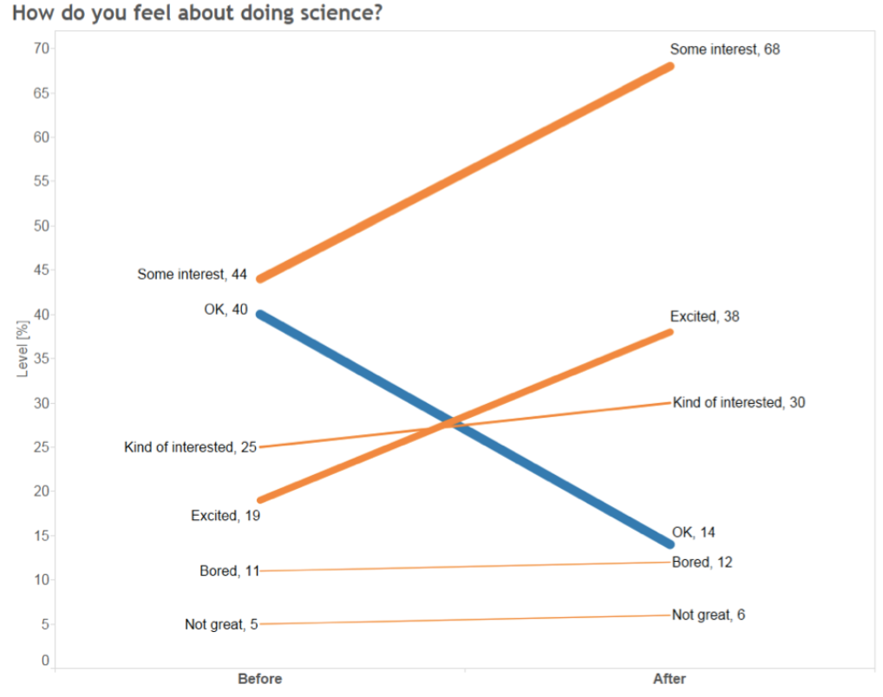
Source: Harvard CS109 – Hanspeter Pfister and Joe Blitzstein
http://cs109.org

Slide 67

Source: Harvard CS109 – Hanspeter Pfister and Joe Blitzstein
http://cs109.org

Slide 68
Perceptual Effectiveness

Slide 69
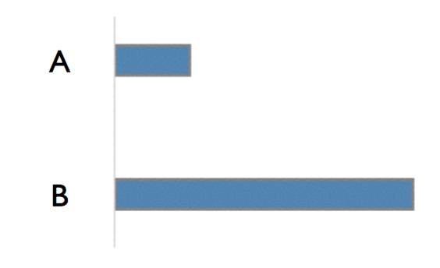
How much longer?
Source: Harvard CS109 – Hanspeter Pfister and Joe Blitzstein
http://cs109.org

Slide 70
How much longer?
4x
Source: Harvard CS109 – Hanspeter Pfister and Joe Blitzstein
http://cs109.org

Slide 71
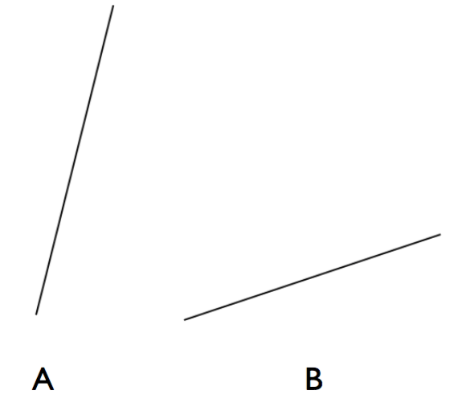
How many times steeper?
Source: Harvard CS109 – Hanspeter Pfister and Joe Blitzstein
http://cs109.org

Slide 72
How many times steeper?
4x
Source: Harvard CS109 – Hanspeter Pfister and Joe Blitzstein
http://cs109.org

Slide 73
How many times steeper?
4x
Source: Harvard CS109 – Hanspeter Pfister and Joe Blitzstein
http://cs109.org

Slide 74
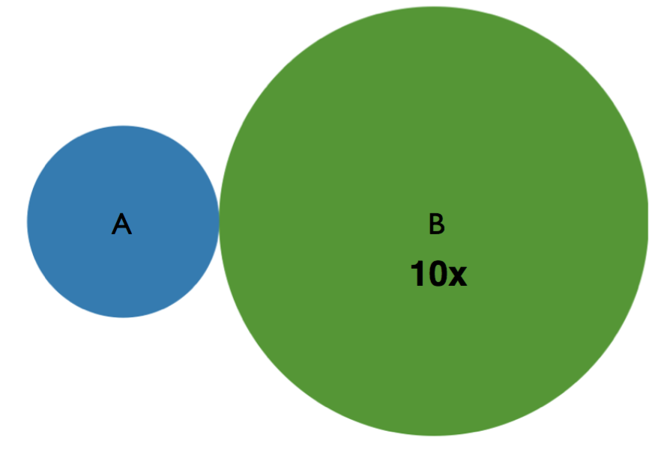
How much larger is the area?
Source: Harvard CS109 – Hanspeter Pfister and Joe Blitzstein
http://cs109.org

Slide 75
How much larger is the area?
Source: Harvard CS109 – Hanspeter Pfister and Joe Blitzstein
http://cs109.org

Slide 76
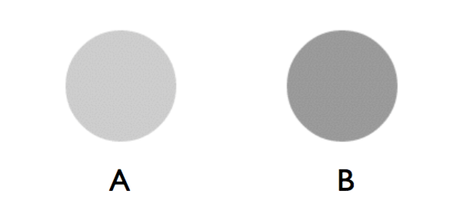
How much darker?
Source: Harvard CS109 – Hanspeter Pfister and Joe Blitzstein
http://cs109.org

Slide 77
How much darker?
2x
Source: Harvard CS109 – Hanspeter Pfister and Joe Blitzstein
http://cs109.org

Slide 78
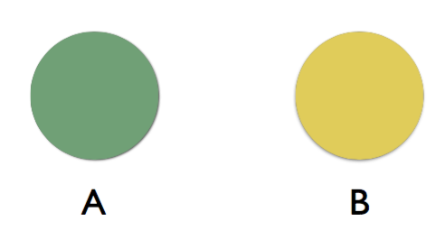
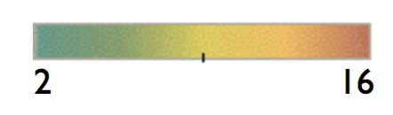
How much bigger value?
Source: Harvard CS109 – Hanspeter Pfister and Joe Blitzstein
http://cs109.org

Slide 79
How much bigger value?
4x
Source: Harvard CS109 – Hanspeter Pfister and Joe Blitzstein
http://cs109.org

Slide 80
How much darker?
2x
Source: Harvard CS109 – Hanspeter Pfister and Joe Blitzstein
http://cs109.org

Slide 81
How much darker?
2x
Source: Harvard CS109 – Hanspeter Pfister and Joe Blitzstein
http://cs109.org

Slide 82
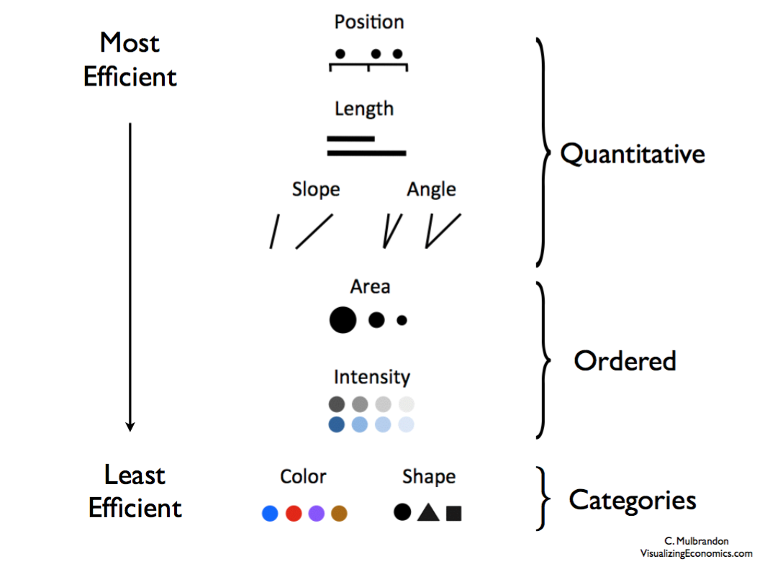
Source: Harvard CS109 – Hanspeter Pfister and Joe Blitzstein
http://cs109.org

Slide 83
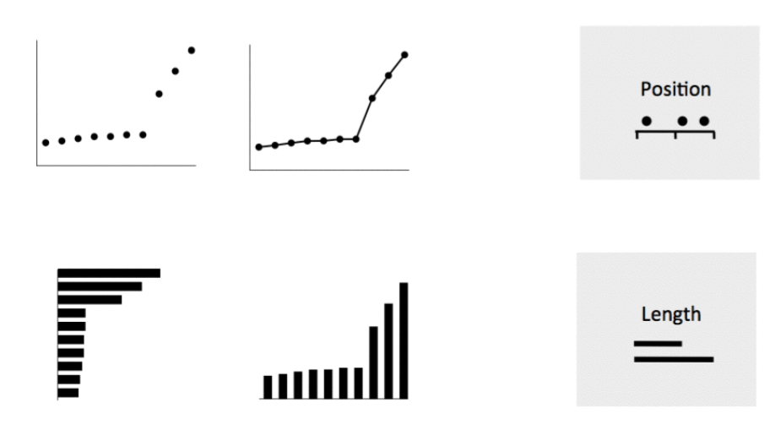
More Effective
Source: Harvard CS109 – Hanspeter Pfister and Joe Blitzstein
http://cs109.org

Slide 84
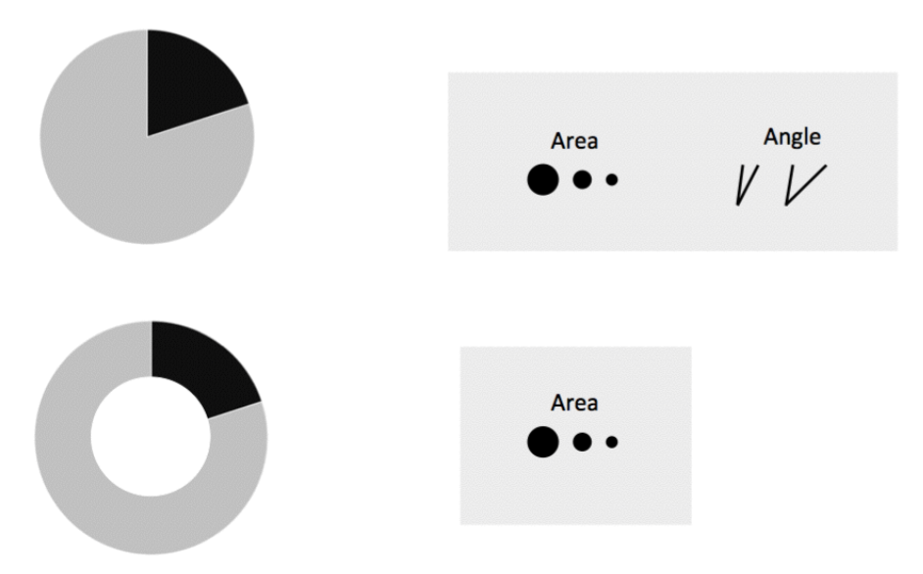
Less Effective
Source: Harvard CS109 – Hanspeter Pfister and Joe Blitzstein
http://cs109.org

Slide 85
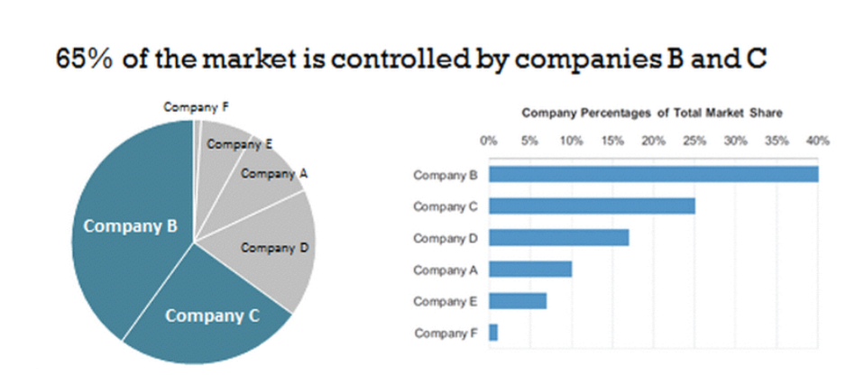
One reason to use Pie over Bar Charts
Source: Harvard CS109 – Hanspeter Pfister and Joe Blitzstein
http://cs109.org

Slide 86
Gestalt Principles of Visual Grouping
How individuals perceive order in the world around them
Identifying which elements in our visuals are signal and which might be noise
Five principles:
Proximity
Similarity
Closure
Continuity
Connection
Source: Harvard CS109 – Hanspeter Pfister and Joe Blitzstein
http://cs109.org

Slide 87
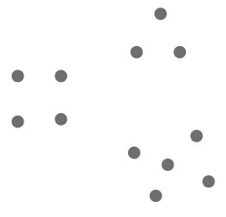

Gestalt Principles: Proximity
Objects that are physically close together are perceived as belonging together
We can influence the perceived orientation of a table simply by changing the spacing between some dots

Slide 88
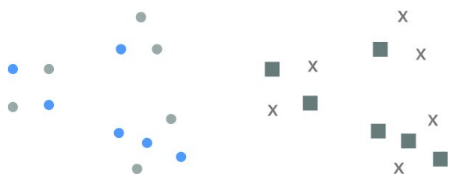

Gestalt Principles: Similarity
Objects that are of similar color, shape, size, or orientation are perceived as related or belong to part of a group
We can use color to guide a reader’s eye while scanning a table

Slide 89


Gestalt Principles: Closure
We like things to be simple and fit in the constructs that are already in our heads. We tend to perceive a set of individual elements as a single, recognizable shape when we can.
We can remove chart borders and background shading and our graph will still appear as a cohesive entity

Slide 90


Gestalt Principles: Continuity
Similar to closure: When looking at objects, our eyes seek the smoothest path and naturally create continuity in what we see even if it may not explicitly exist
Here we have removed the y-axis and we can still see the bars aligned because of consistent white space between the labels and the data

Slide 91


Gestalt Principles: Connection
We tend to think of objects that are physically connected as part of a group. The connectivity property typically has a stronger associative value than similar color, size, or shape.
We use this principle in line graphs to help our eyes see order in the data

Slide 92


Enclosure
We think of objects that are physically enclosed together as belonging to part of a group

Slide 93
Use Color Strategically

Slide 94

Color Discriminability
Source: Harvard CS109 – Hanspeter Pfister and Joe Blitzstein
http://cs109.org

Slide 95

Colors for Categories
Source: Ware, “InformationVisualization”, Adapted from:
Harvard CS109 – Hanspeter Pfister and Joe Blitzstein
http://cs109.org

Slide 96

Colors for Ordinal Data
Source: Harvard CS109 – Hanspeter Pfister and Joe Blitzstein
http://cs109.org

Slide 97

Colors for Ordinal Data
Source: Harvard CS109 – Hanspeter Pfister and Joe Blitzstein
http://cs109.org

Slide 98

Rainbow Colormap
Source: Harvard CS109 – Hanspeter Pfister and Joe Blitzstein
http://cs109.org

Slide 99
Perceptually nonlinear
Source: Harvard CS109 – Hanspeter Pfister and Joe Blitzstein
http://cs109.org

Slide 100

Color blindness
Source: Harvard CS109 – Hanspeter Pfister and Joe Blitzstein
http://cs109.org

Slide 101

Color blindness
Source: Harvard CS109 – Hanspeter Pfister and Joe Blitzstein
http://cs109.org

Slide 102

Colorbrewer
Source: Harvard CS109 – Hanspeter Pfister and Joe Blitzstein
http://cs109.org

